Slide 1
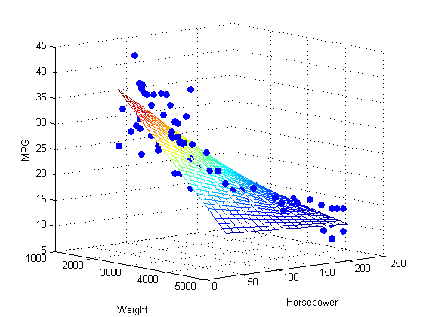
Ridge Regression Analysis on Correlates of Cars’ Miles Per Gallon
Jiannan(Jeffrey) Zhang
University of Texas at Austin

Slide 2
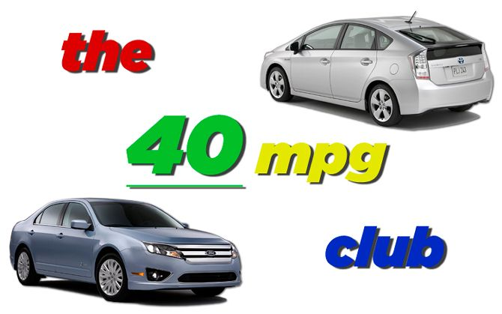
Introduction
Concerns about the fuel supply and fuel efficiency have been growing significantly in recent years
Many scholars believe that investing in technologies to increase the fuel economy of America's vehicle fleet will create domestic jobs, save consumers money at the pump, cut global warming pollution

Slide 3
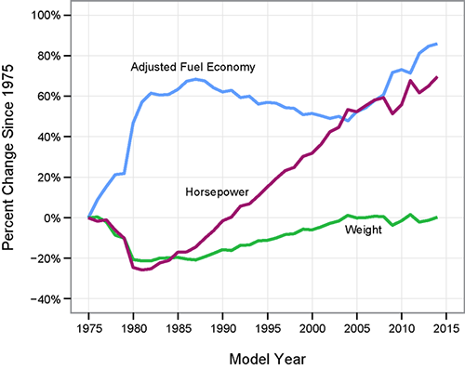
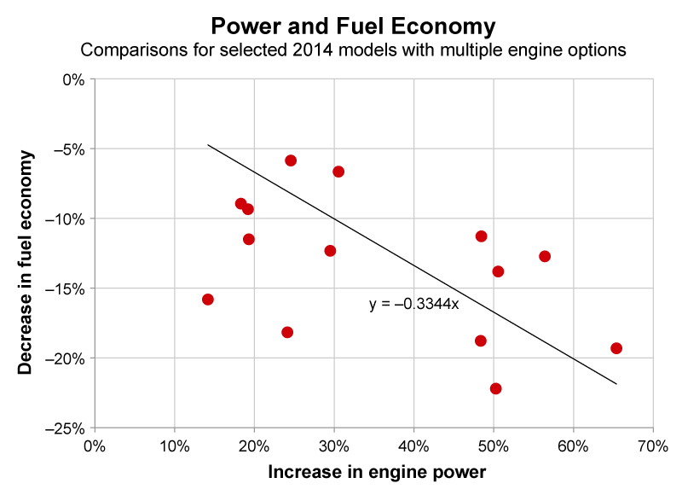
Introduction
There are many factors affecting MPG such as horsepower (HP), weight, and year of the car. My study focuses on using ridge regression to analyze the correlations between a car’s MPG and seven predictor variables (number of cylinders, engine displacement, HP, weight of the vehicle, acceleration time, origin country and the year of the car)

Slide 4
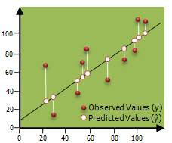
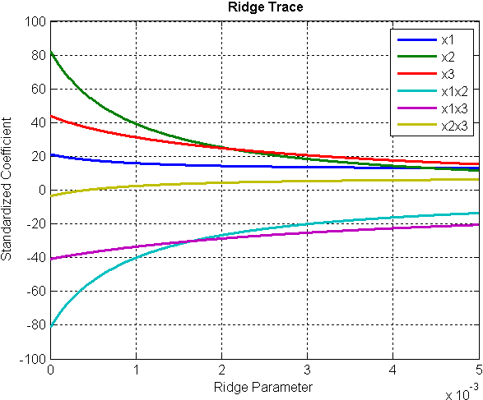
Introduction
Why ridge regression ?
The general way to do the regression is to use Ordinary Least-Squares (OLS) Regression

Slide 5
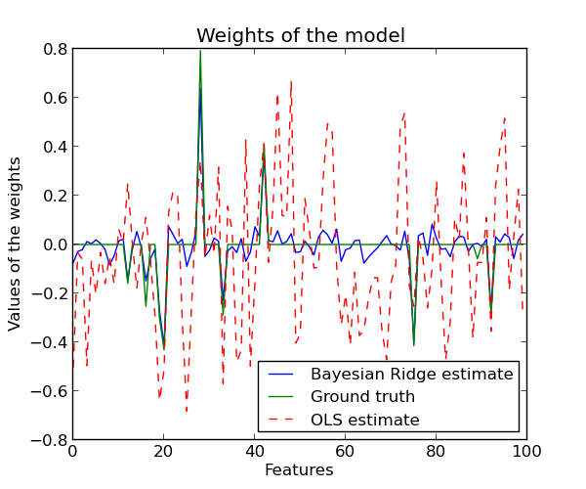
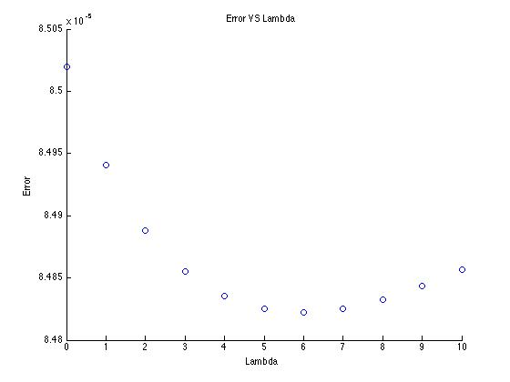
Main methods: 1. Ridge regression
Error for OLS regression
The size of the weights is controlled. Therefore the model is more stable.
In my study, another goal is to find the best ridge parameter (Lambda) that minimizes the ERROR
Error for ridge regression is smaller!

Slide 6
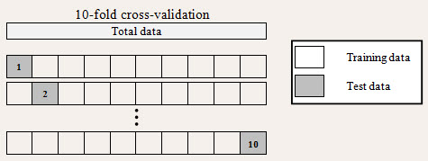
Main methods: 2. Cross-validation
I used ten-fold cross-validation
Every time I use nine folds to train data and one fold to test data
Used to limit problems like overfitting

Slide 7
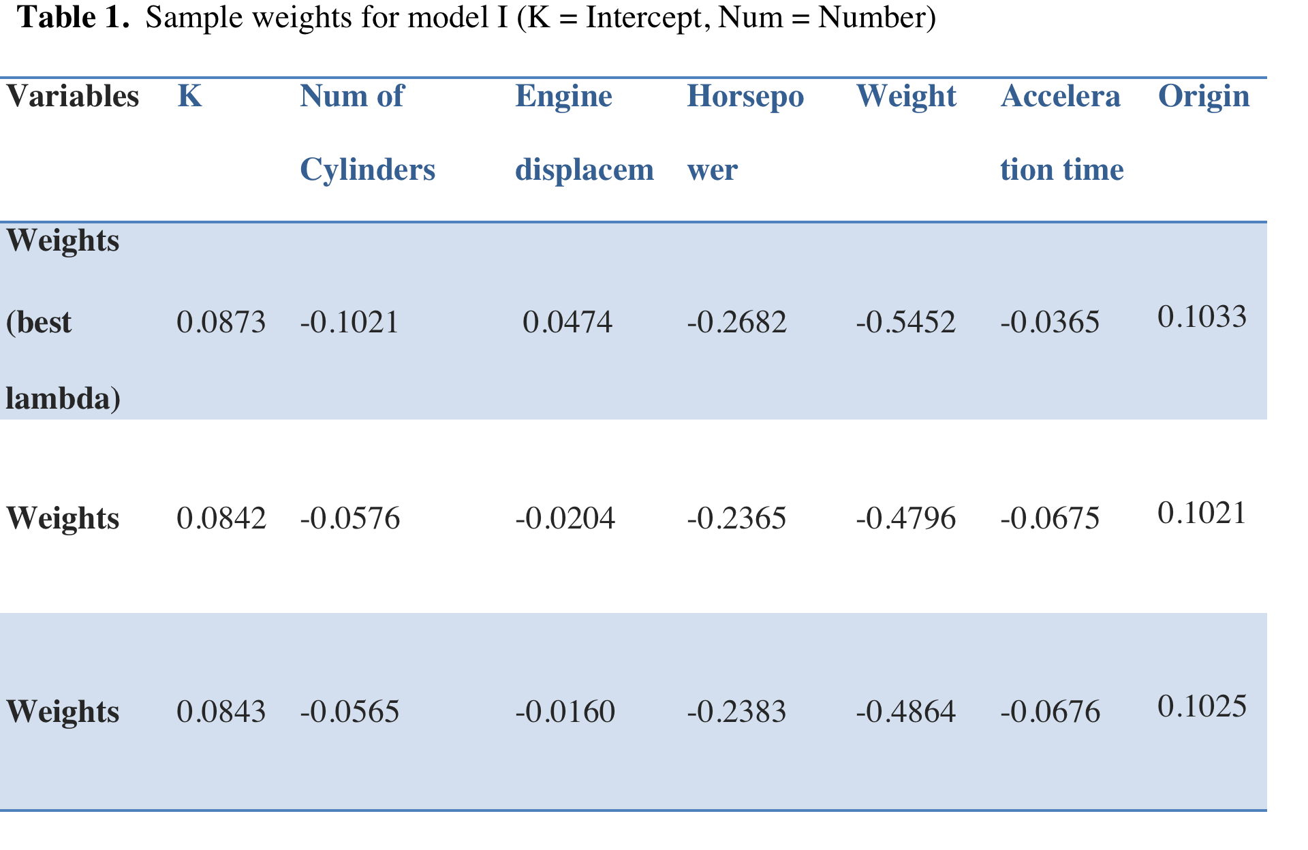
Results
Model I (data set with six features : number of cylinders, engine displacement, HP, weight, acceleration time, origin country)

Slide 8
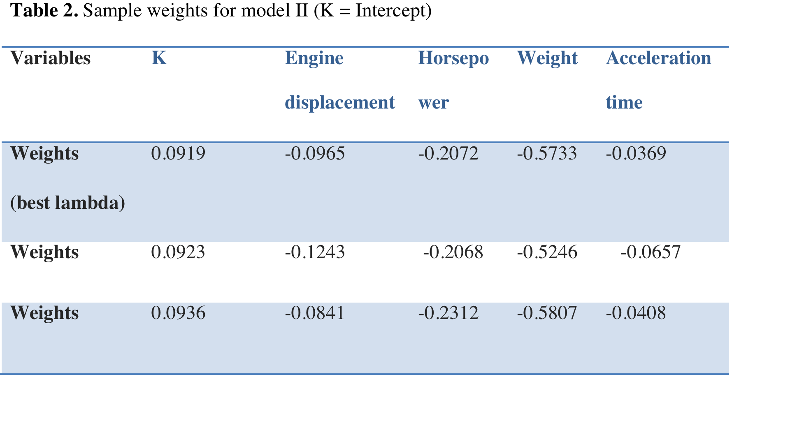
Results
Model II (data set with all continuous variables : engine displacement, HP, weight, acceleration time)

Slide 9
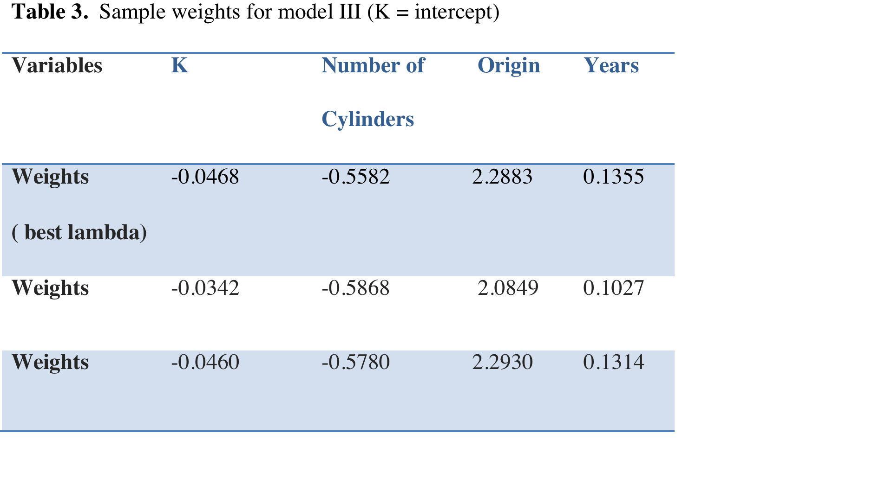
Results
Model III (data set with all discrete variables : number of cylinders, origin country, years)

Slide 10
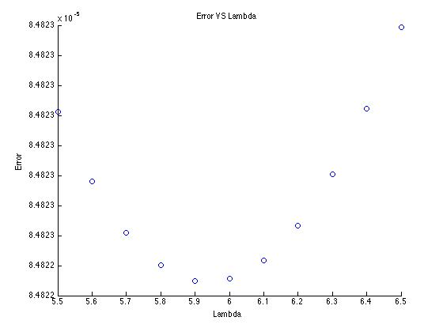
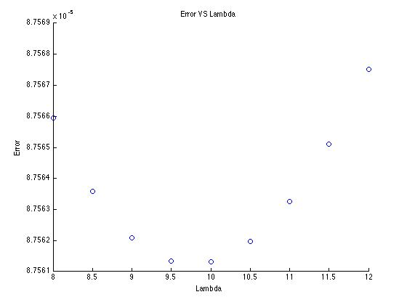
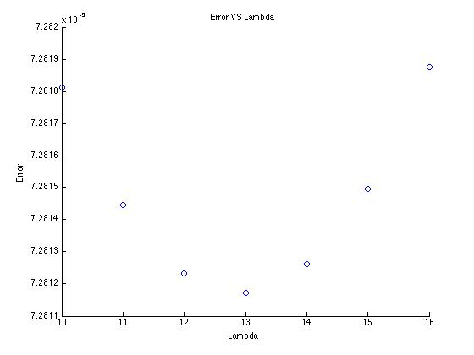
Results
Plots of Error VS Lambda for three models
Model I
Model II
Model III

Slide 11
Discussion
Weight of the car and HP are best two predictors for the MPG in Model I (compare all the features together).
Five variables that are negative correlated with MPG. They are number of cylinders, engine displacement, HP, weight of the vehicle and acceleration time.
Two variables that are positively correlated with MPG. They are year of the car and the country origin of the car. Japanese cars usually have the highest MPG, followed by Germany cars and American cars

Slide 12
Discussion
Ridge regression is better than OLS regression in this study
By controlling the size of coefficients, ridge regression is a good way to battle multicollinearly for a large set of predictor variables in a regression model
Error for OLS regression
Error for ridge regression is smaller!
Error for OLS regression
Error for ridge regression is smaller!

Slide 13
Acknowledgements
Jiannan(Jeffrey) Zhang
University of Texas at Austin

Slide 14


